Slide 1
Operating Room Team Training With Simulation Program
Patient Safety Forum March 30, 2017
Bill Berry, MD, MPA, MPH Associate Medical Director in Surgery, CRICO Chief Medical Officer, Ariadne Labs
Kathy Dwyer, MS, RN Senior Program Director, Patient Safety, CRICO
Notes:
- Keep your title simple.
- Use the first subtitle for the subtitle of your presentation
- Use the “2nd subtitle” for your name, job, title, etc. ← This is optional!

Slide 2
Overview of Surgical-related Malpractice Data
Between 2011-2016, surgical-related cases account for nearly 25% of CRICO’s total incurred loss
Most common contributing factors were technical performance (50%) and ineffective communication (23%)
Deeper analysis of surgical cases revealed
  Preventable adverse outcomes often related to poor communication and teamwork
  Response or lack of response to technical error because of inadequate communication often contributed significantly to patient’s injury
Total incurred includes reserves on open and payments on closed cases.

Slide 3
Harvard Surgical Chiefs Safety Collaborative
CRICO’s long role in harmonizing safety standards - e.g., Harvard Anesthesia Standards; team training in Anesthesia and Obstetrics with premium reduction
Goal: Joint effort to identify areas to work together to improve patient safety in surgery and decrease malpractice risk; projects include
  Fundamentals in Laparoscopy Skills
  Resident to attending communication triggers
  Grant to adopt sponge tracking technology
  Harvard Surgery Code of Excellence
  360 reviews for surgeons
  OPERATING ROOM TEAM TRAINING WITH SIMULATION

Slide 4
Program Requirements Include
A simple team training curriculum
Debriefer training course
Multidisciplinary team training sessions
  4-6 hours in length
  challenging surgical scenarios
  facilitated debriefing
  engage realism
Three components
  safety checklist
  speaking up
  practicing close loop communication techniques

Slide 5
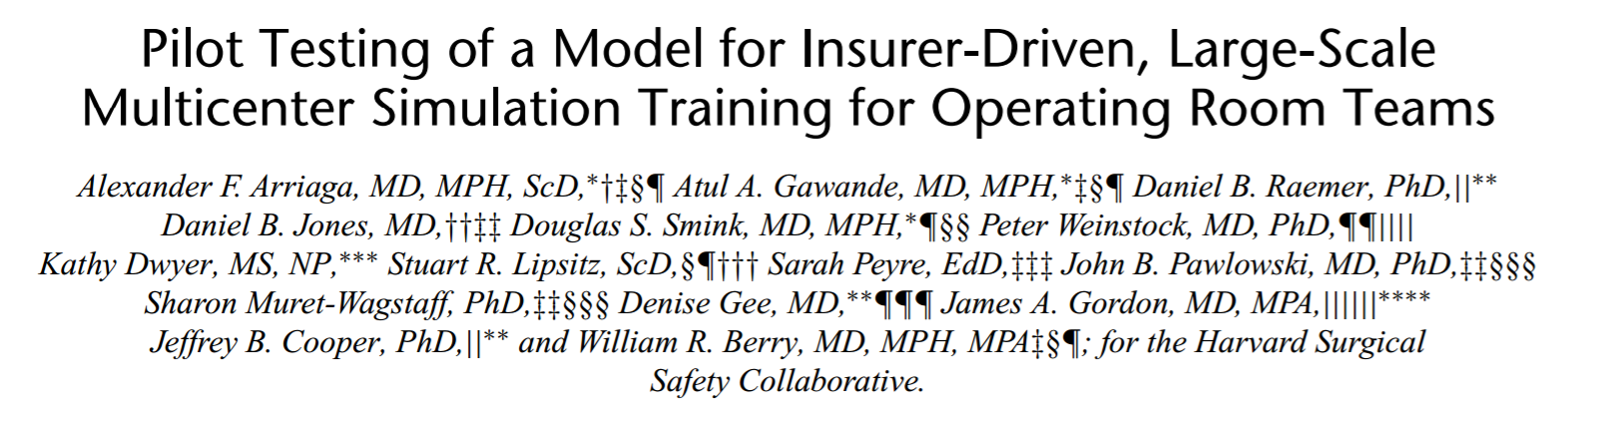
Program Requirements Included
Three case scenarios
  hemorrhage
  cardiac arrest outside OR
  case based on institution’s choice

Slide 6
CRICO Board Support and Participation
Educational grant
Premium rebate for surgeons
Eleven institutions participating
Seven surgical specialties
Over 425 surgeons and their teams
Three approaches
  High fidelity simulation
  Low fidelity simulation
  In situ

Slide 7
Results and Sustainability
Over 97 percent of participants rated the overall course as above average or excellent
Over 80 percent of participants rated improved communication skills post training
Improved safety culture in the operating room
Moved simulation-based team training into the fabric of the institutions
Shorter duration, more frequently reinforced training opportunities in teamwork

Slide 8
Lessons Learned
Engage key stakeholders early
Collaborations can be powerful
Keep programs simple
Provide some structure
Allow individual creativity and ownership
Pilot learnings informed the scale-up
Malpractice premium rebate an important lever
Support from Harvard Surgical Chiefs Safety Collaborative

Slide 9
What would you do differently
Cultivate support at the highest levels
Consider engaging chief financial officers early in the process
Explore during the project ways to make the training more efficient and less costly
Perform an ongoing assessment of recommended resources to inform the broader implementation
Obtain baseline information/data around existing safety cultures in operating rooms and safety event data

Slide 10
Video

Slide 11
Contact Information
Kathy Dwyer kdwyer@rmf.harvard.edu
617-450-6806

Slide 12

Dedicated to creating the safest
health care system in the world.

